Slide 1

Flutter.io
Paetow Rolf, Dominik Seifert

Slide 2
Das (geistige) Vorbild: React (native)
Parallelen:
State
Responsiveness
Multiplattform
Nutzt nativen code „You can expect excellent performance. Flutter is designed to help developers easily achieve a constant 60fps. Flutter apps run via natively compiled code – no interpreters are involved. This means Flutter apps start quickly.“
https://flutter.io/faq/#what-kind-of-app-performance-can-i-expect

Slide 3
Was macht Flutter anders?
Facebook mit React: It’s worth noting that we’re not chasing “write once, run anywhere.” Different platforms have different looks, feels, and capabilities, and as such, we should still be developing discrete apps for each platform, but the same set of engineers should be able to build applications for whatever platform they choose, without needing to learn a fundamentally different set of technologies for each. We call this approach “learn once, write anywhere.” – Tom Occhino¹
Google mit Flutter: “Write once, run anywhere”.
¹ https://code.facebook.com/posts/1014532261909640/react-native-bringing-modern-web-techniques-to-mobile/
Notes:
In June 2017, we measured the size of a minimal Flutter app (no Material Design, just a single Center widget, built with flutter build apk), bundled and compressed as a release APK, to be approximately 6.7MB.
For this simple app, the core engine is approximately 3.3MB (compressed), the framework + app code is approximately 1.25MB (compressed), the LICENSE file (contained in app.flx) is 55k (compressed), necessary Java code (classes.dex) is 40k (compressed), and there is approximately 2.1MB of (compressed) ICU data.

Slide 4
Vorraussetzungen
Mac/Windows/Linux
Git (command line tools)
Flutter SDK
Android Studio/XCode
Android Emulator/Device od. iOS Simulator/Device
Visual Studio Code od. Intelli J Idea.
Grundkenntnisse im Umgang mit Dart.

Slide 5
Google Dart
Entwickelt als JavaScript Alternative
Objektorientiert (Klassen, Interfaces, Vererbung), optional Typsicher
Lässt sich zu JavaScript umwandeln
Jede Dart Datei hat seinen isolierten state/scope.
Isolates (isolierte Prozesse mit eigenem Heap in Dart VM)
Dart:
elem.query('#foo'); elem.queryAll('.foo');
JavaScript:
getElementsById(), getElementsByTagName(), getElementsByName(), getElementsByClassName(), querySelector(), querySelectorAll(), document.links, document.images, document.forms, document.scripts, formElement.elements, selectElement.options...

Slide 6
Google Dart - Why did Flutter choose to use Dart?
Developer productivity. One of Flutter’s main value propositions is that it saves engineering resources by letting developers create apps for both iOS and Android with the same codebase. Using a highly productive language accelerates developers further and makes Flutter more attractive.
Object-orientation. For Flutter, we want a language that’s suited to Flutter’s problem domain: creating visual user experiences. The industry has multiple decades of experience building user interface frameworks in object-oriented languages. While we could use a non-object-oriented language, this would mean reinventing the wheel to solve several hard problems.
Predictable, high performance. With Flutter, we want to empower developers to create fast, fluid user experiences. In order to achieve that, we need to be able to run a significant amount of end-developer code during every animation frame. That means we need a language that both delivers high performance and delivers predictable performance, without periodic pauses that would cause dropped frames.
Fast allocation. The Flutter framework uses a functional-reactive style programming model, whose performance depends heavily on the underlying memory allocator efficiently handling small, short-lived allocations. The functional-reactive style was developed in languages with this property and does not work efficiently in languages that lack this facility.
https://flutter.io/faq/#what-kind-of-app-performance-can-i-expect

Slide 7
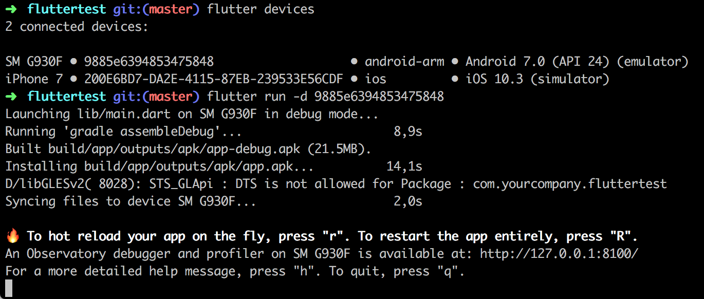
Workflow
flutter create myapp (and cd to newly created folder)
(flutter devices)
flutter run (-d <device id>)

Slide 8
Features

Slide 9
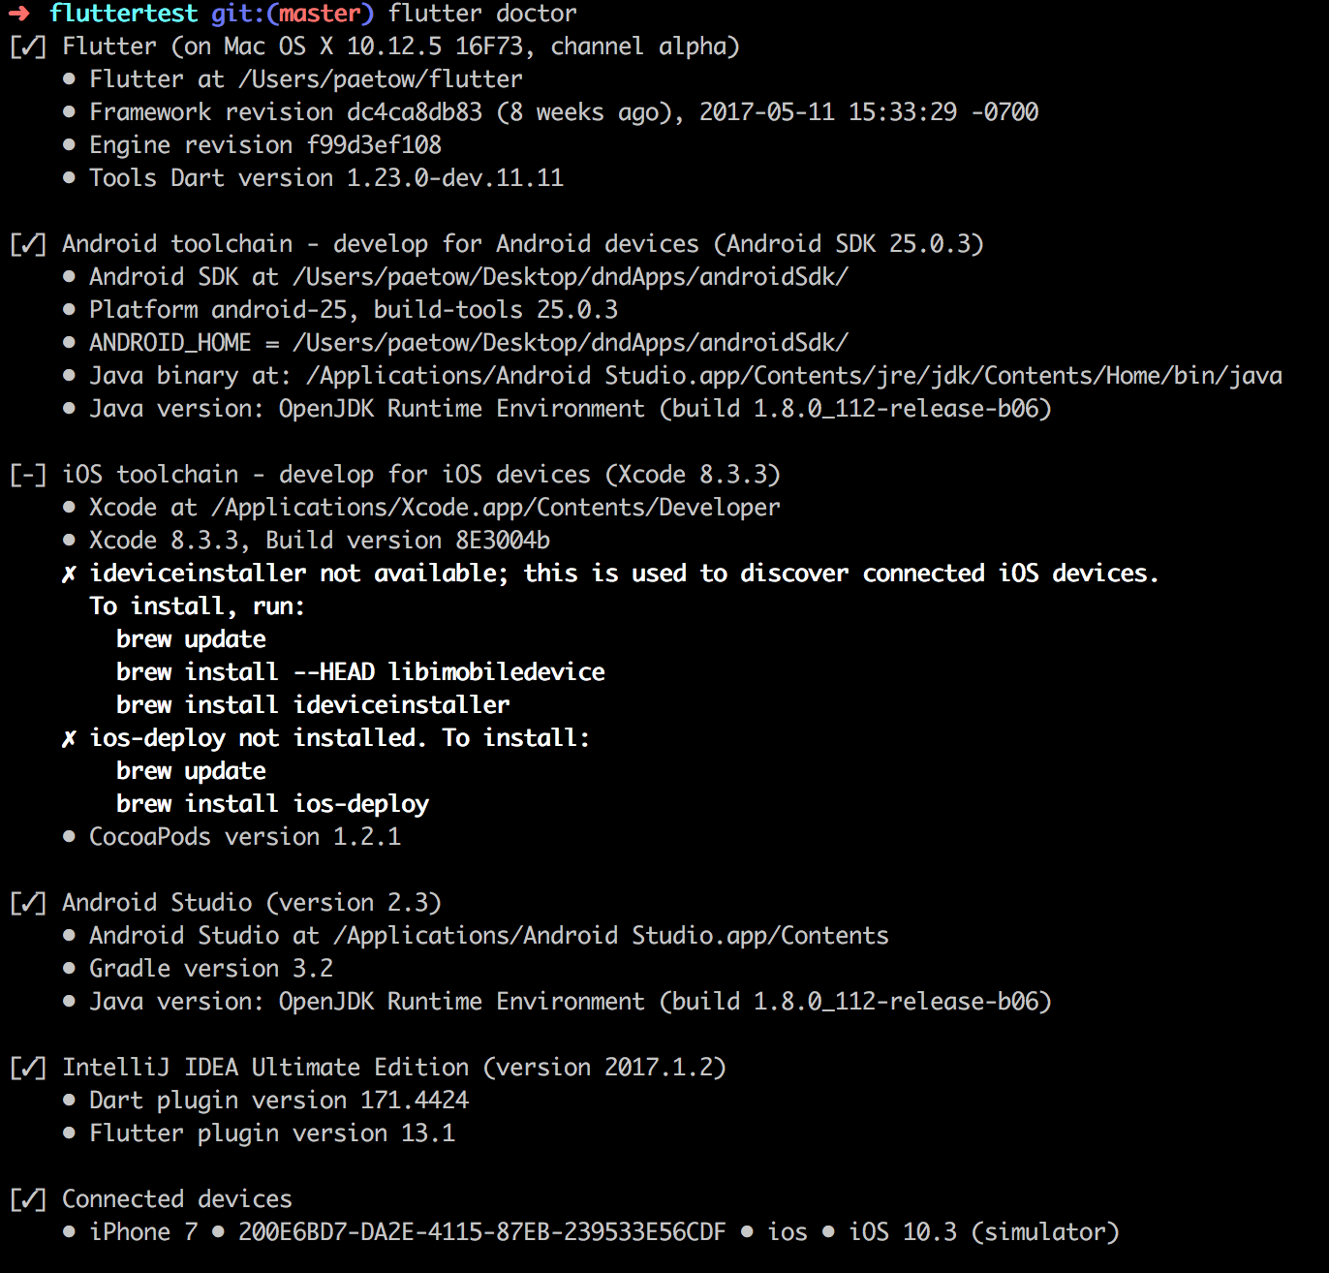
Flutter Doctor
Tool zum Überprüfen der gesamtem Flutter
Toolchain
Zeigt auf einem Blick ob Updates verfügbar sind...
...und wo es Probleme geben könnte.

Slide 10
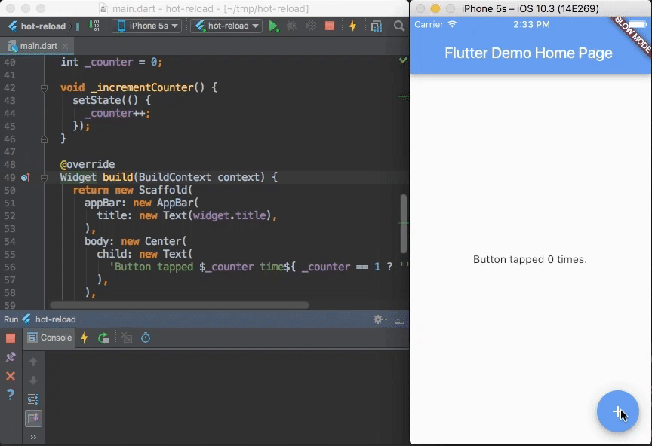
Hot reload
https://flutter.io/getting-started/

Slide 11
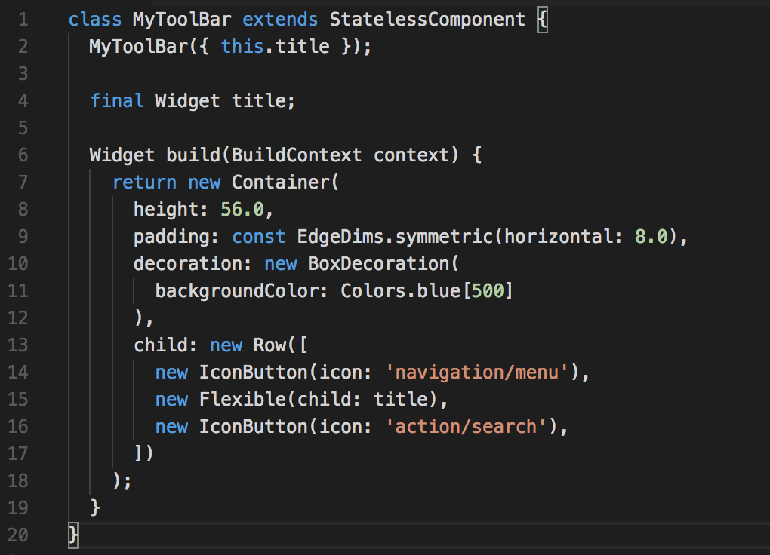
Widgets
Text: stylebares Textfeld
Row, Column: Widget für Layouts in horizontaler (Row) und verticaler (Column) Ausrichtung. (vgl. CSS3 Flexbox).
Stack: -> Widget um mehrere Widgets übereinander darzustellen (FiFo ,absolute positioning).
Container: -> div

Slide 12
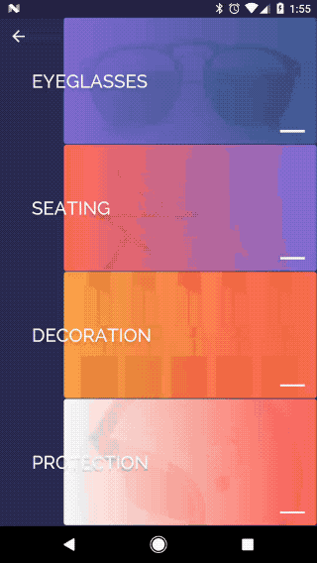
State
Stateless Widgets: Sind statisch und verändern sich nicht z.B. Icon, IconButton & Text erben von StatelessWidget
Stateful Widgets: Widgets mit denen der User interagieren kann z.B. Checkbox, TextField & Slider erben von StateFulWidget Zustand wird in zusätzlichem StateObject gesichert --> .setState() führt zur Neuzeichnung des Widgets

Slide 13
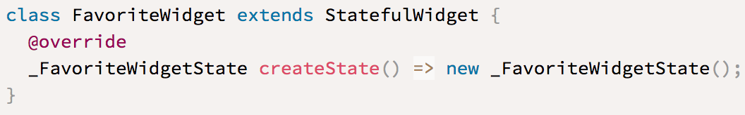
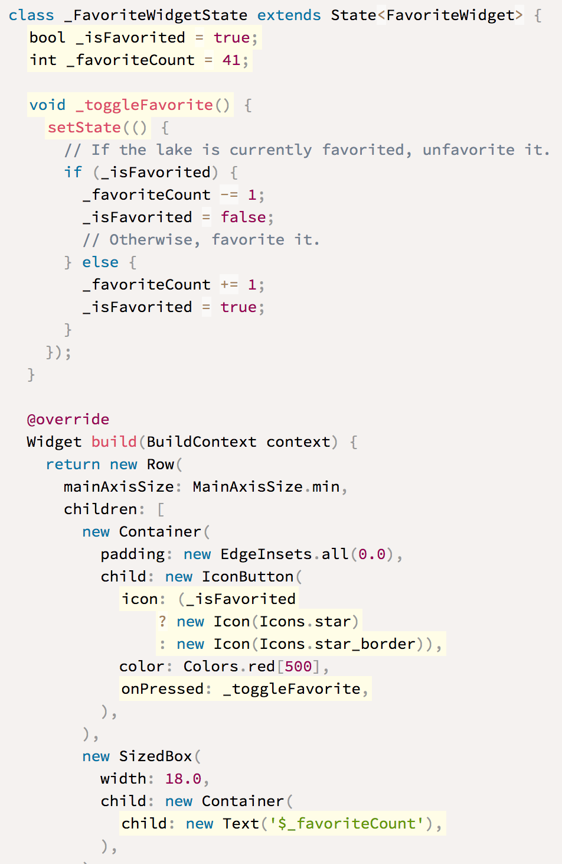
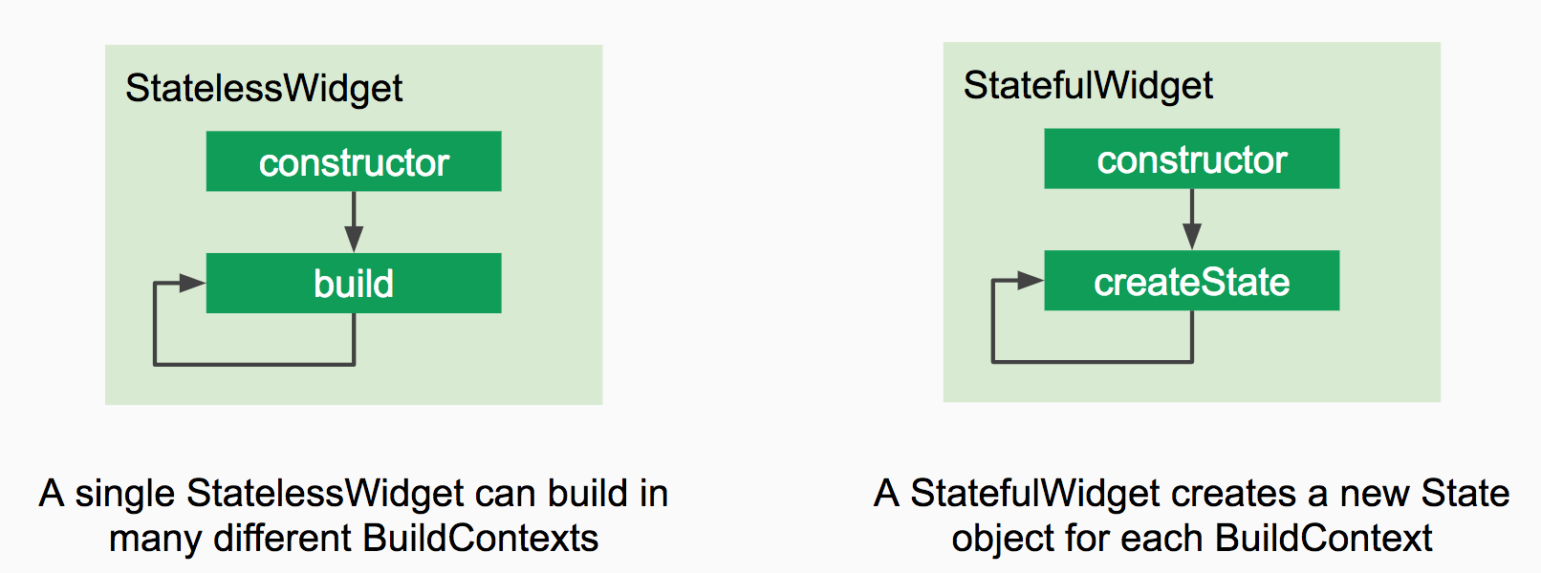
- createState() um den State selbst zu managen
- setState() führt zum Neuzeichnen des Widgets nach Toggle Interaktion
Notes:
The FavoriteWidget class manages its own state, so it overrides createState() to create the State object. The framework calls createState()when it wants to build the widget. In this example, createState() creates an instance of _FavoriteWidgetState, which you’ll implement in the next step. The custom State class stores the mutable information—the logic and internal state that can change over the lifetime of the widget. When the app first launches, the UI displays a solid red star, indicating that the lake has “favorite” status, and has 41 “likes”. The state object stores this information in the _isFavorited and _favoriteCount variables.
The state object also defines the build method. This build method creates a row containing a red IconButton, and Text. The widget usesIconButton, (instead of Icon), because it has an onPressed property that defines the callback method for handling a tap. IconButton also has an icon property that holds the Icon.
Why is the build() method on State, not StatefulWidget?
Putting a Widget build(BuildContext context) method on State rather putting a Widget build(BuildContext context, State state)method on StatefulWidget gives developers more flexibility when subclassing StatefulWidget.

Slide 14
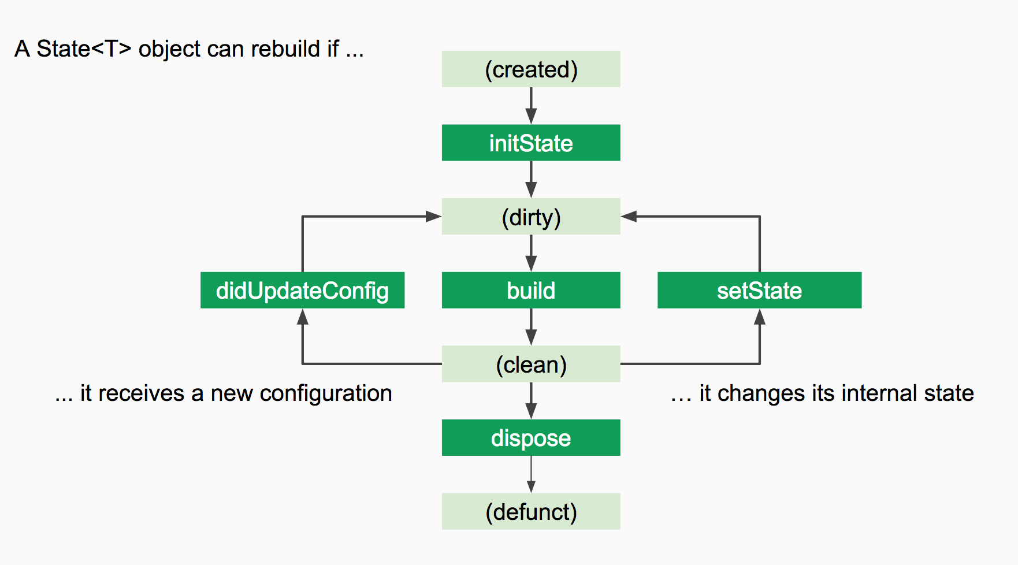
State<T> lifecycle
https://docs.google.com/presentation/d/1cw7A4HbvM_Abv320rVgPVGiUP2msVs7tfGbkgdrTy0I/edit#slide=id.g70d668005_2_22

Slide 15
Packaging
dependencies:
fluro: "^1.1.0“
http: '>=0.11.3+12'
https://pub.dartlang.org/packages/fluro
https://flutter.io/networking/

Slide 16
Unterbau

Slide 17
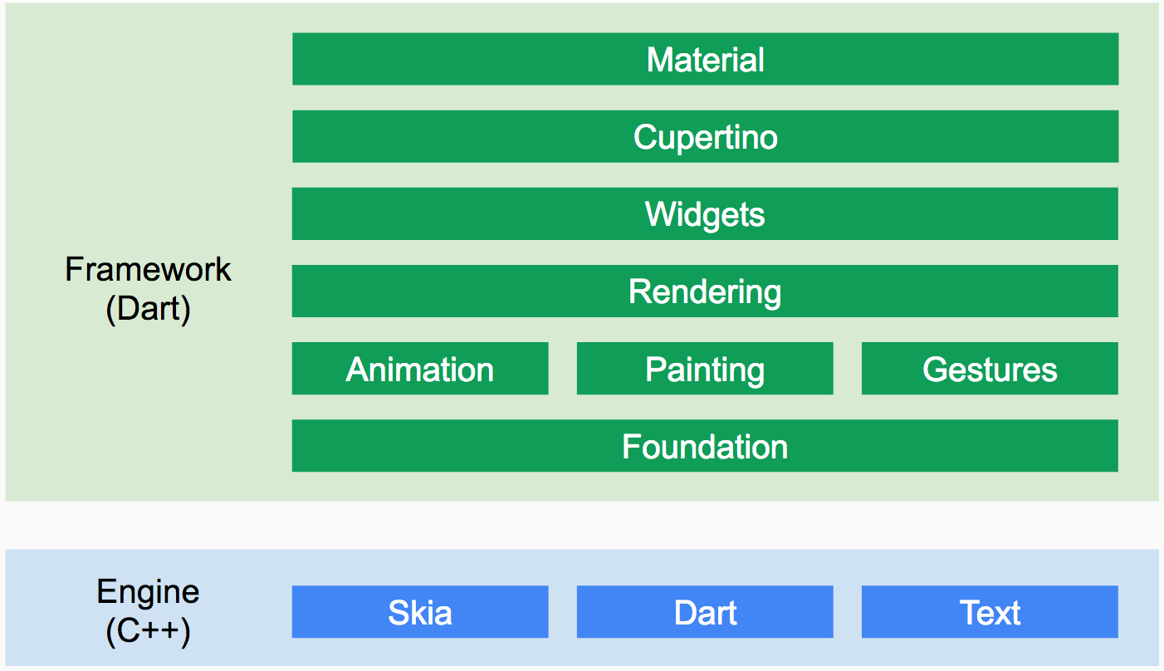
Render Pipeline
https://docs.google.com/presentation/d/1cw7A4HbvM_Abv320rVgPVGiUP2msVs7tfGbkgdrTy0I/edit#slide=id.g70d668005_2_22
Notes:
Does Flutter use my system’s OEM widgets?
No. Instead, Flutter provides a set of Material Design and Cupertino (iOS-styled) widgets, managed and rendered by Flutter’s framework and engine. You can browse a catalog of Flutter’s widgets.
We are hoping the end-result will be higher quality apps. If we reused the OEM widgets, the quality and performance of Flutter apps would be limited by the quality of those widgets.
In Android, for example, there’s a hard-coded set of gestures and fixed rules for disambiguating them. In Flutter, you can write your own gesture recognizer that is a first-class participant in the gesture system. Moreover, two widgets authored by different people can coordinate to disambiguate gestures.
Modern app design trends point towards designers and users wanting more motion-rich UIs and brand-first designs. In order to achieve that level of customized, beautiful design, Flutter is architectured to drive pixels instead of the OEM widgets

Slide 18
“native“ Ausführung des Codes
How does Flutter run my code on Android?
The engine’s C/C++ code is compiled with Android’s NDK, and the majority of the framework and application code is running as native code compiled by the Dart compiler.
How does Flutter run my code on iOS?
The engine’s C/C++ code is compiled with LLVM, and any Dart code is AOT-compiled into native code. The app runs using the native instruction set (no interpreter is involved).
Flutter in existing Apps
Aufrufen nativen Codes
„Flutter supports calling into the platform, including integrating with Java code on Android, and ObjectiveC or Swift code on iOS. This is enabled via a flexible message passing style where a Flutter app may send and receive messages to the mobile platform using a BasicMessageChannel.“
https://flutter.io/faq/#can-i-use-flutter-inside-of-my-existing-native-app
Notes:
-> AOT Compiling != JIT Compiling

Slide 19
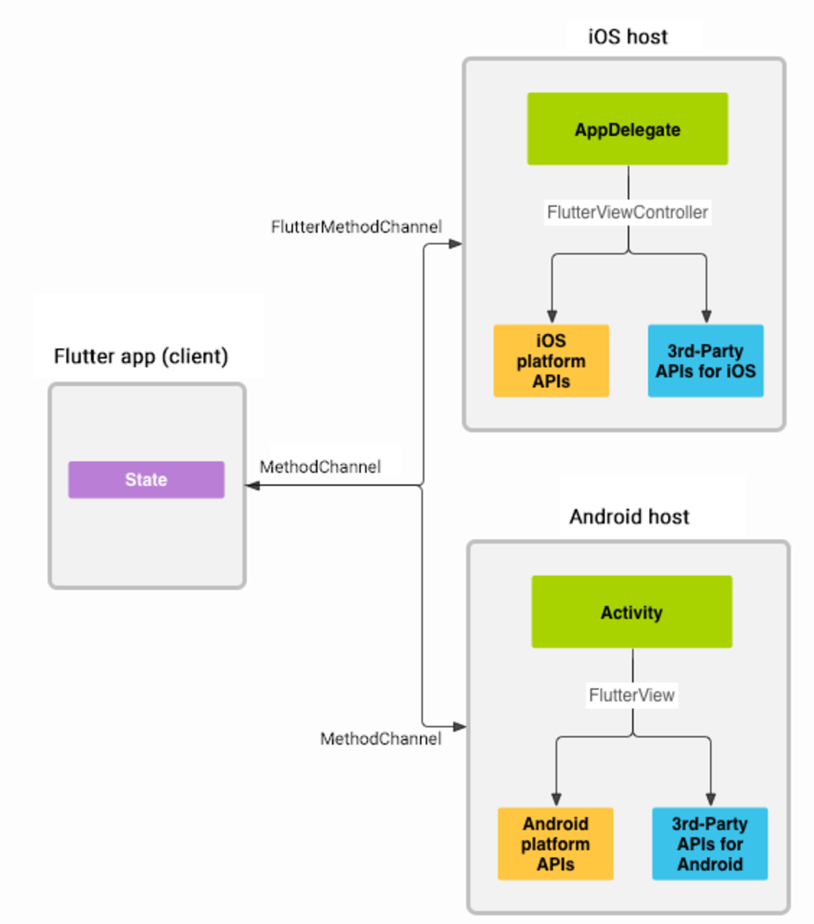
Ansprechen native Bestandteile über Channels
Notes:
On the client side, MethodChannel (API) enables sending messages that correspond to method calls. On the platform side, MethodChannel on Android (API) and FlutterMethodChannel on iOS (API) enable receiving method calls and sending back a result. These classes allow you to develop a platform plugin with very little ‘boilerplate’ code.

Slide 20
Einbinden von Android Code
„We [...] build for Android using the same standard 'gradle-based' build process that Android Studio project uses. This makes it easier to edit the native Android code; [...] you can open the android folder in Android Studio, and it will know how to build the project, and will allow you to add java code.“¹
¹ https://github.com/flutter/flutter/wiki/Upgrading-Flutter-projects-to-build-with-gradle

Slide 21
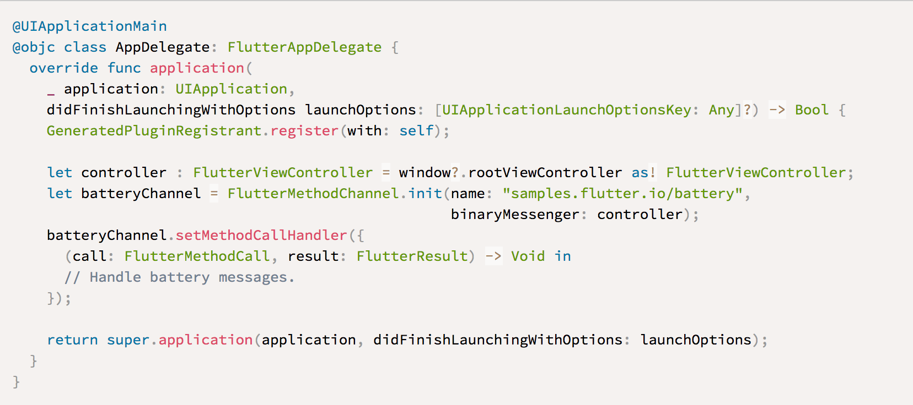
Einbinden von iOS Code

Slide 22
Release
flutter build ios
flutter build apk (flutter build defaults to --release).
Notes:
Will Apple reject my Flutter app?
We can’t speak for Apple, but Apple’s policies have changed over the years, and they have allowed apps built with systems like Flutter. We are aware of apps built with Flutter that have been reviewed and released via the App Store.
Of course, Apple is ultimately in charge of their ecosystem, but our goal is to continue to do everything we can to ensure Flutter apps can be deployed into Apple’s App Store.

Slide 23
Danke für die Aufmerksamkeit

